Slide 1

Python Visualization Dashboards with Plotly's Dash Library

Slide 2
11. Plotly Basics Overview

Slide 3
Plotly Basics Overview
We’ll start by showing a static lineplot using pandas and matplotlib

Slide 4
Plotly Basics Overview
Create a file called basic1.py
import numpy as np
import pandas as pd
import matplotlib.pyplot as plt
# create fake data:
df = pd.DataFrame(np.random.randn(100,4), columns='A B C D'.split())
df.plot()
plt.show()

Slide 5
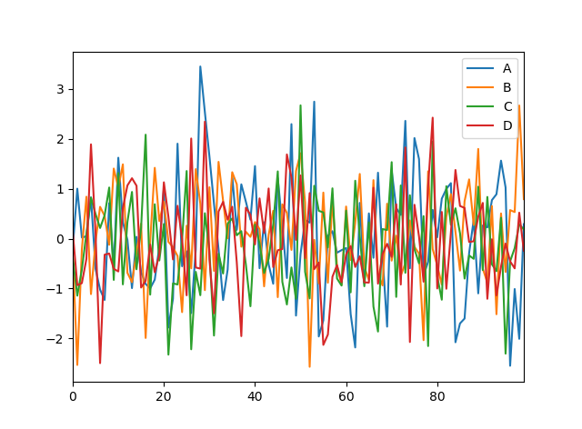
Plotly Basics Overview
Run the file: python basic1.py
You can resize the image, but that’s about it
Close the image window to end the script.

Slide 6
Plotly Basics Overview
Next we’ll use the same dataframe to create a plotly plot in the browser.

Slide 7
Plotly Basics Overview
Create a file called basic2.py
import numpy as np
import pandas as pd
import plotly.offline as pyo
import plotly.graph_objs as go
# create fake data:
df = pd.DataFrame(np.random.randn(100,4), columns='A B C D'.split())
pyo.plot([{
'x': df.index,
'y': df[col],
'name': col
} for col in df.columns])

Slide 8
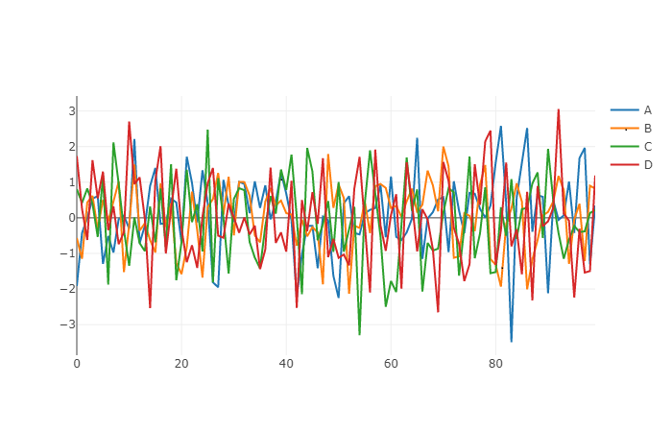
Plotly Basics Overview
Run the file: python basic2.py
Each colored line is called a “trace”.
You can click once on a trace to remove it from the plot, or double-click the trace to isolate it.

Slide 9
12. Scatter Plots

Slide 10
Scatter Plots
We’ll start by showing a basic scatter plot with fake data, just to compare the different types of plots available.
Next we’ll import a simple dataset to plot actual data.

Slide 11
Scatter Plots
Create a file called scatter1.py
import numpy as np
import pandas as pd
import plotly.offline as pyo
import plotly.graph_objs as go
# create fake data:
N = 500
x = np.linspace(0, 1, N)
y = np.random.randn(N)
df = pd.DataFrame({'x': x, 'y': y})
pyo.plot({
"data": [go.Scatter(x=df['x'], y=df['y'],mode='markers')],
"layout": go.Layout(title="simple scatter")

Slide 12
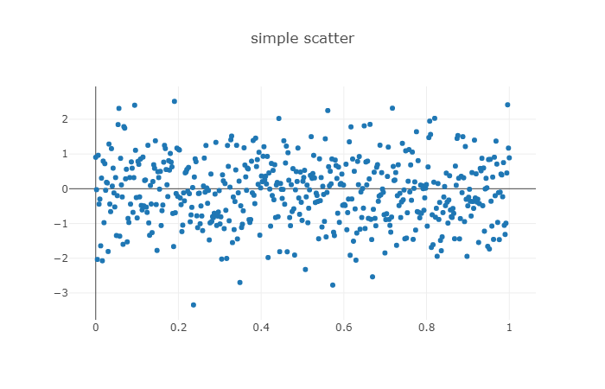
Scatter Plots
Run the file: python scatter1.py
This plots 500 points from 0 to 1 against random y-axis values that are normal about zero.

Slide 13
Scatter Plots
In the previous plot we chose mode='markers'
Let’s compare two other modes: mode='lines+markers' mode='lines'
Create a file called scatter2.py:

Slide 14
Scatter Plots
import numpy as np
import pandas as pd
import plotly.offline as pyo
import plotly.graph_objs as go
# create fake data:
N = 100
random_x = np.linspace(0, 1, N)
random_y = np.random.randn(N)
# create traces
trace0 = go.Scatter(
x = random_x,
y = random_y+5,
mode = 'markers',
name = 'markers'
)
trace1 = go.Scatter(
x = random_x,
y = random_y,
mode = 'lines+markers',
name = 'lines+markers'
)
trace2 = go.Scatter(
x = random_x,
y = random_y-5,
mode = 'lines',
name = 'lines'
)
data = [trace0, trace1, trace2]
pyo.plot(data, filename='scatter-mode')

Slide 15
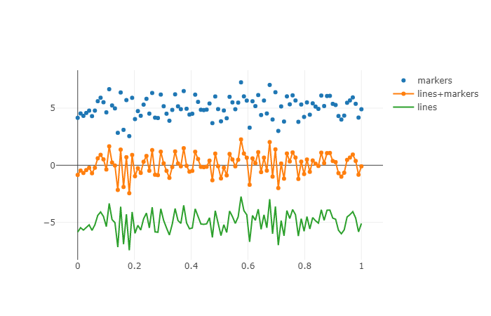
Scatter Plots
Run the file: python scatter2.py
This plots the same 100 points in three different regions, showing the different display modes available.

Slide 16
Deep Learning
Outputs
Colors used for shapes or figures should be the default Google slide colors on level “Light 1”.
Hidden
Inputs

Slide 17
Complete Python Bootcamp
Code should be written in Source Code Pro
if 1==2::
print(“Woah”)
elif 1==1:
print(“One is equal to One”)
else::
print(“Everything Normal”)

Slide 18
Complete Python Bootcamp
Syntax Highlighting is encouraged
if 1==2::
print(“Woah”)
elif 1==1:
print(“One is equal to One”)
else::
print(“Everything Normal”)

Slide 19
Complete Python Bootcamp
Colors used should be defaults on Dark 1
if 1==2::
print(“Woah”)
elif 1==1:
print(“One is equal to One”)
else::
print(“Everything Normal”)

Slide 20
Complete Python Bootcamp
Also nice to use boxes to highlight features
if 1==2::
print(“Woah”)
elif 1==1:
print(“One is equal to One”)
else::
print(“Everything Normal”)

Slide 21
Lecture 2

Slide 22
Deep Learning
First slide of lecture 2.

Slide 23
Example Simple Autoencoder
Box 1
Box 2

